Slide 1
Tutorial - Customer Analytics
Abhishek Rishabh
December 2019
ISB

Slide 2
Motivation
Today we will figure out ways to
Find new customers
Targeting existing customers
Retaining our existing customers

Slide 3
Case 1 –Segmentation.
How do we find new set of customers for our business?
What information do we have now?
Information on our current customers.
This information can be helpful to find new customers. How?
We know what are the ‘type’ of customer who are likely to buy from us.
We can identify segments by geography, demographics, behavioral characteristics etc.

Slide 4
Case 1 – Segmentation.
Identified market segments should apply to the larger group of consumers, both current customers and potential customers.
What method comes to your mind?
Clustering.

Slide 5
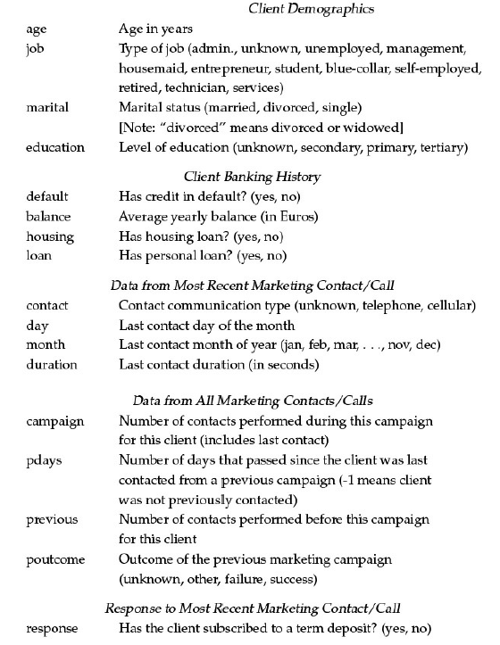

Slide 6
Case 2 – Targeting.
Your senior management asks you to devise a targeting plan for a product.
Should you target all the customers?
Which customers will you target and why? Also, how?

Slide 7
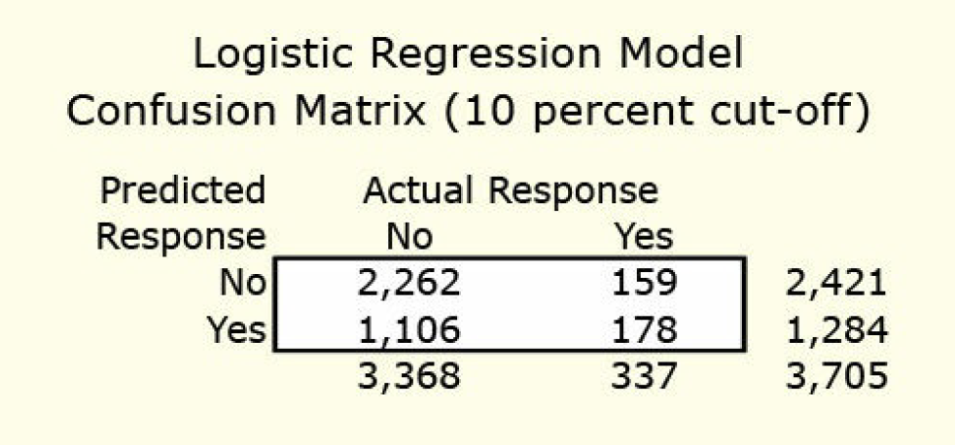
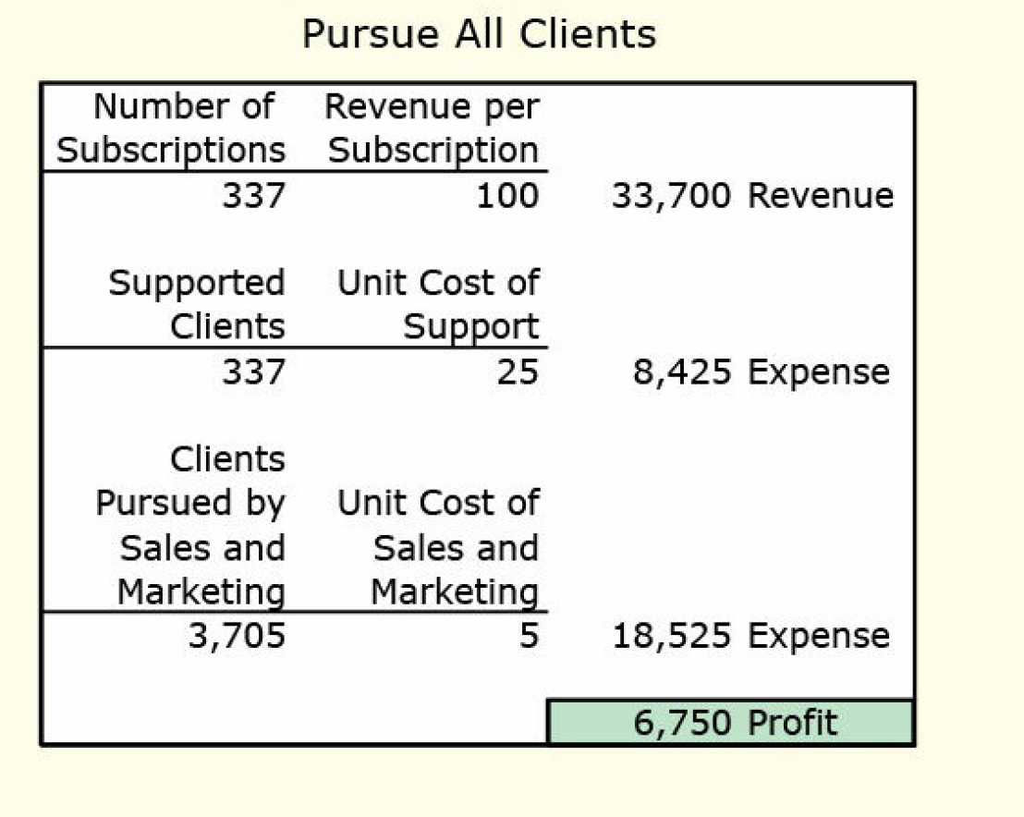
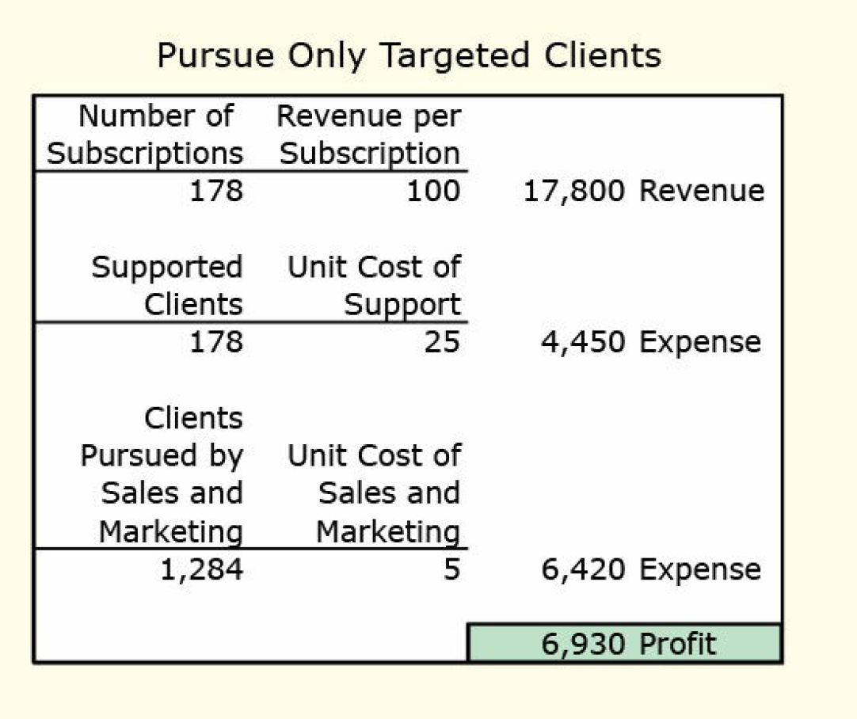
Case 2 – Targeting

Slide 8
Case 3 – Retention.
You have certain set of customers.
There is a rival product available in the market.
The customers might switch.
How can you retain them?

Slide 9
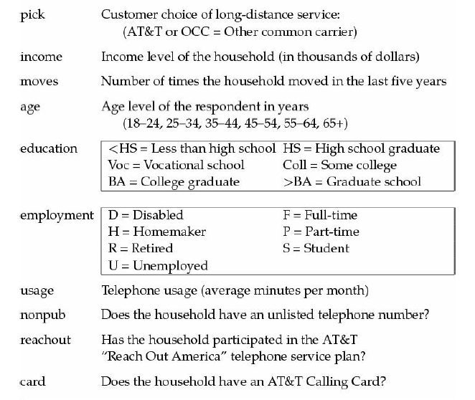
Case 3 – Retention.

